Slide 1
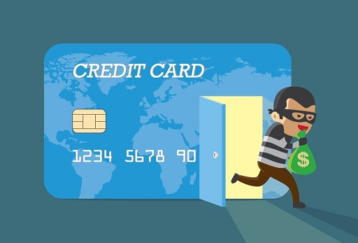
Presented by: Sourav Sahu Amrutansu Patra Anurag Kumar
Credit Card Fraud Detection

Slide 2
Introduction to Credit Card Fraud Detection.
Introduction to Data
Model Training
Creating Web App
Sneak Peek into Our Web App
Conclusion
Overview

Slide 3
Introduction to Credit Card Fraud Detection
Need of the hour.
Complex
Technological Limitations

Slide 4
Introduction to the Data

Slide 5
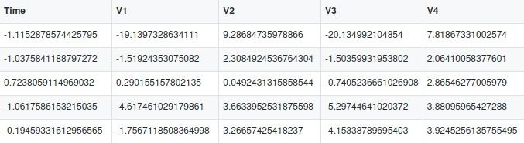
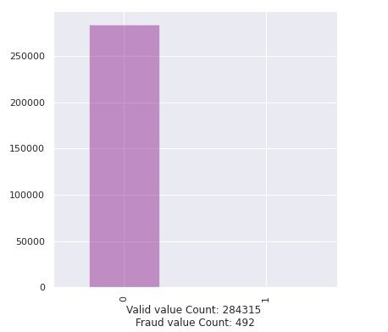
Dimensionally reduced
Unbalanced

Slide 6
Logistic Regression with balanced Class Weight.
Model Training
Over Sampling and Under Sampling
Accuracy: 0.976
Recall: 0.903

Slide 7
Creating Web App

Slide 8
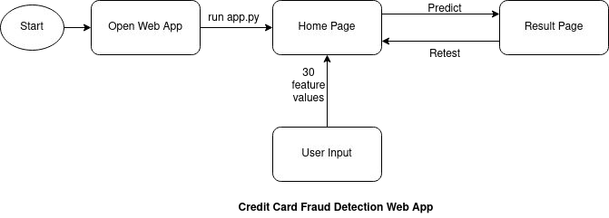

Slide 9
Sneak Peek into Our Web App

Slide 10
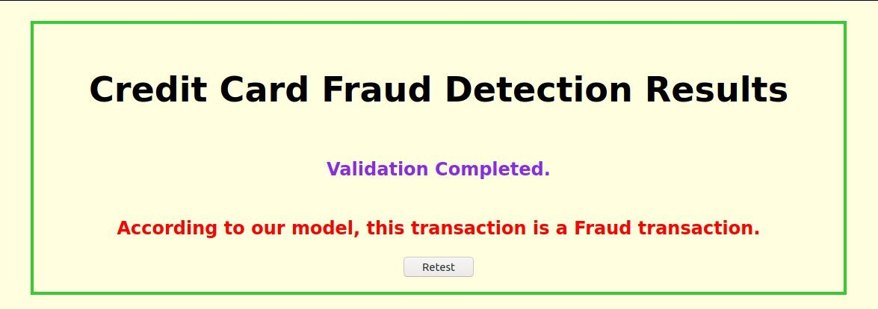
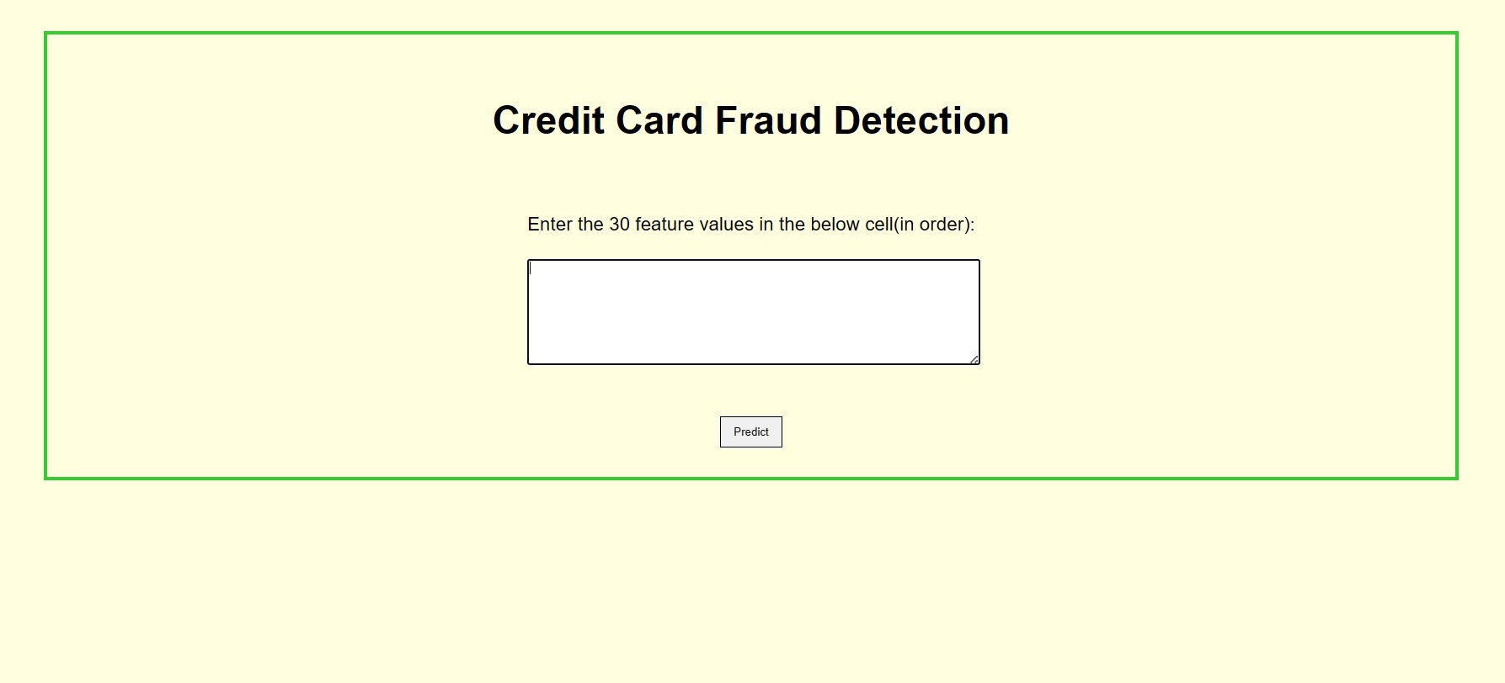
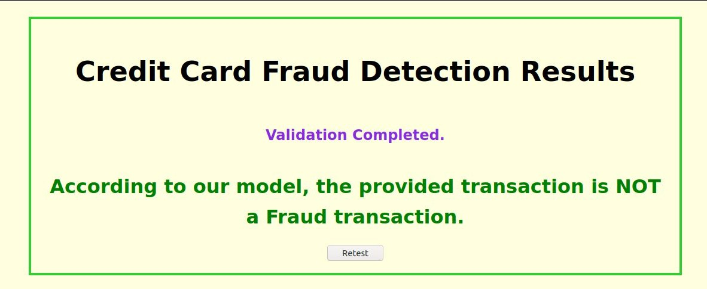

Slide 11
Credit Card Fraud Detection is a developing technique.
Conclusion
Machine Learning advances will achieve greater results in future.

Slide 12
Thank You!

